Slide 1

BIKE RENTAL FOR SUSTAINABLE ENVIRONMENT
GROUP - F
SUSTAINABILITY ENGINEERING 2022
DATE : 24/10/2022
PRANUJ RAI
RISHABH SHUKLA
MD.HASSAN SHARIF
GILBERT KWAME ADU
PHILEMON FRIMPONG
S M MUZAHIDUL ISLAM

Slide 2
AGENDA
Introduction
Problem Statement
Related Existing Solutions
Our Design Methodology
User’s Evaluation
Result’s
Conclusion
Our Solutions

Slide 3

Introduction &
Existing Solution
Rishabh Shukla
Gilbert
Problem
Statement
Md. Hassan Sharif
Our Solution
Philemon Frimpong
Methodology & UI
Pranuj Rai
SM Muzahidul Islam
User Evaluation
Conclusion &Result
Rishabh Shukla
Pranuj Rai
Md. Hassan Sharif
PROJECT WORK CONTRIBUTION

Slide 4
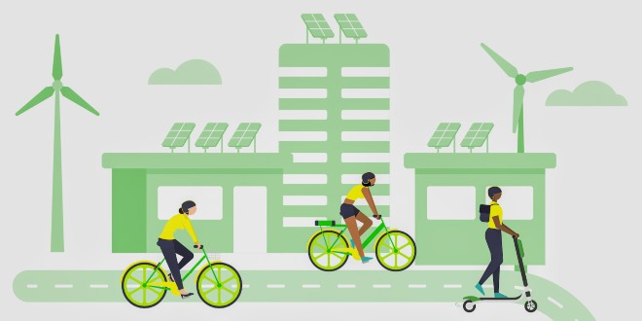
INTRODUCTION TO BIKE RENTAL FOR SUSTAINABLE ENVIRONMENT
The issue of the extensiveness of private car use is currently the main barrier in many urban areas.
Bike rentals programs are thought to be a useful strategy for promoting alternate modes of transportation and can be utilized as a component of improving sustainable mobility in communities.
Users of the bike-rental system can borrow a bike at one of the automated stations scattered across the city, ride it to their destination, and then return it to that station or vice versa.
I hope and I believe that this Template will your Time, Money and Reputation. I hope and I believe that this Template will your Time, Money and Reputation.

Slide 5

PROBLEM STATEMENT
01
Urban population rate has highly increased in the last decades.
04
Individuals produce numerous trips with diverse purposes.
02
Peoples are focused on cities.
05
The excessive use of several vehicles causes significant negative impacts.
03
Urban mobility is a relevant human activities in cities.
06
Pollution emitted by vehicles is harmful for environment and public health.
TITLE HERE

Slide 6


EXISTING SOLUTIONS
We grouped our findings of the existing solution in three broad categories:
Traditional / First Generation
Bicycles are provided for free without any restrictions
No registration, Identification, fee, locks etc. Suitable for smaller cities
Good effect: Everyone has access to it. Bad effect: Stolen, vandalized and damaged
Mid / Second Generation
Bicycles are provided for a small fee and restricted movement
Usually managed by the community or state. Suitable of mid-size cities
Good effect: No registration, Durable bikes and safe. Bad effect: Fees, No tracking systems
Third Generation
Registration and Identification, low fees, safe, durable
Mostly automated, managed by private companies
Good effect: More sustainable. Bad effect: Limited tracking systems

Slide 7
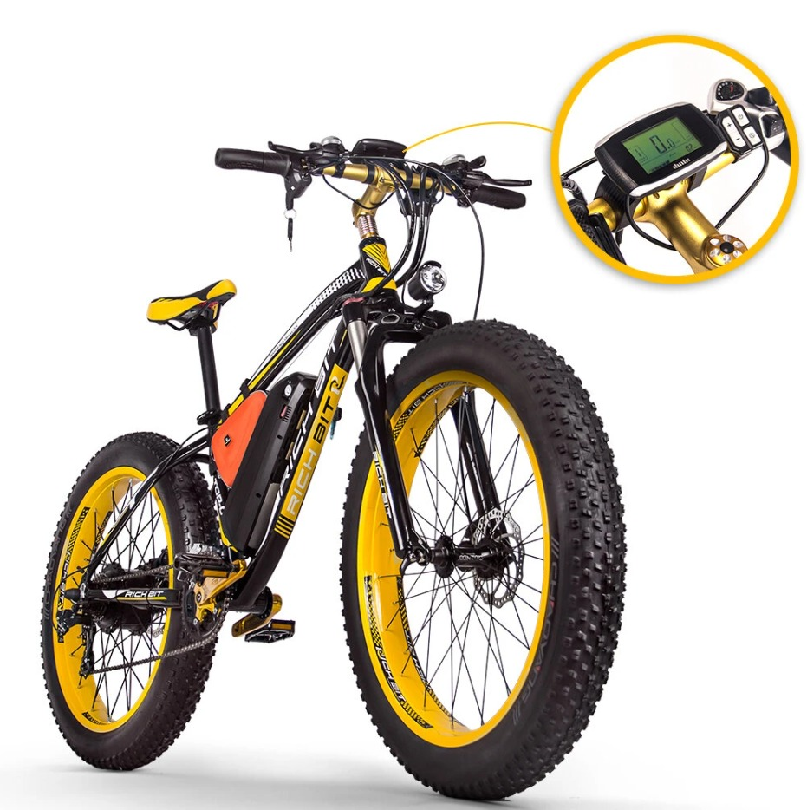

OUR SOLUTION
1. With regards to the increase in the prices of fuel, we aim to provide affordable, safe and convenient electric bicycles which would ensure customers save a lot of money even with long distances.
​
3. Using our bicycle would ensure a reduction to direct ecological intrusion, improve productivity because it avoids traffic. Public workers do not have to hire taxis but could use our bicycles for their everyday transportation.
2. Since we want to ensure substantial reduction in carbon and encourage more people to use our bicycle, we have provided an in-built AI system which would ensure stability, gives awards to the distance covered by the customer and offer discounts on the next rides.

Slide 8
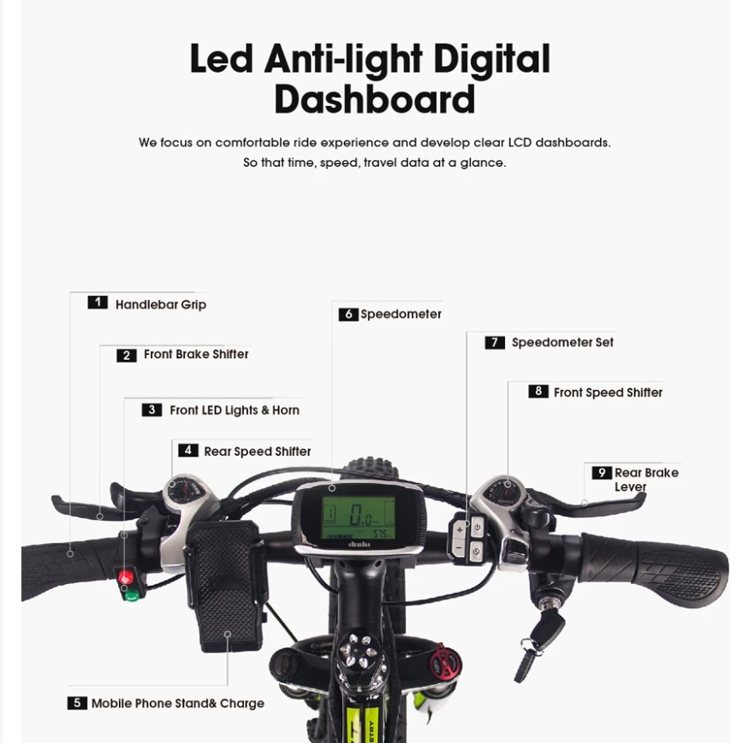
OUR SOLUTION
We aim to provide an electric Bicycle which has awesome features such as:
1. Anti-Light Digital Screen: that would track customer data eg. The Speed, distance covered, Battery Capacity without looking on your phone. ​
2. Self-Riding button: This new bicycle can be adjusted to a constant speed which would help customers not to use so much strength when riding. Customers can press and hold the buttons to increase the speed or reduce. Self-riding option can be turned on and off anytime.
3. Provision of mobile phone holder and charging system: We aim to encourage more people to use bicycle considering the numerous benefits, customers who wants to ride long distances can charge their mobile phones through the USB-Type B & C ports provided.
4. Mobile Application and GPS: Customers should be able to unlock the application to be able to use the bicycle. This is done through the mobile app which has registration and login features. The GPS would be enabled to identify where these bicycles are parked.
5. Big and strong wheels: Our bicycle is design to suit all weather conditions. Bigger types with strikes would be able to use in both cold and hot places.
​
.

Slide 9
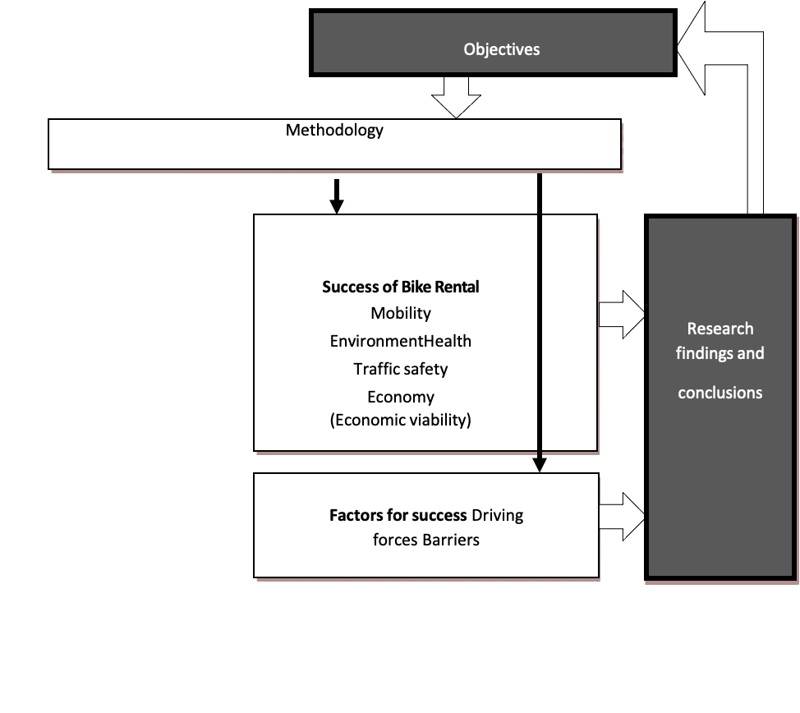
Selection and description of project
METHODOLOGY

Slide 10




HOW IT WORK'S ?
STEP 03
STEP 01
Rent
STEP 04
STEP 02
Availability.
End & Pay

Slide 11
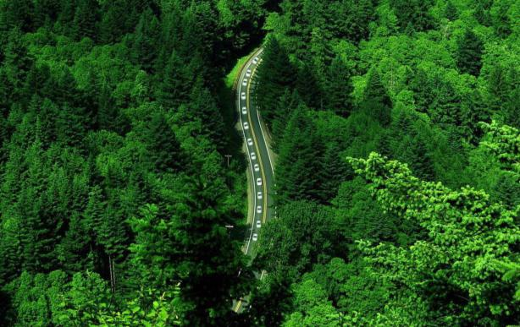

OUR INNOVATION & IT'S DESIGN- USE CASE DIAGRAM
Smartphone
Smart Display
Database
Start Ride
Create log of travel
Receive travel log
Receive travel log
Suggest alternative travel route
Display notification & status
Analyze the past travel history
Receive notification
Generate report of total Journey
Generate an alert message based on smartphone
Generate report of total carbon footprint
Send travel data to mobile App

Slide 12


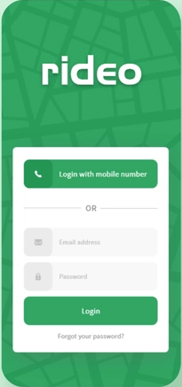
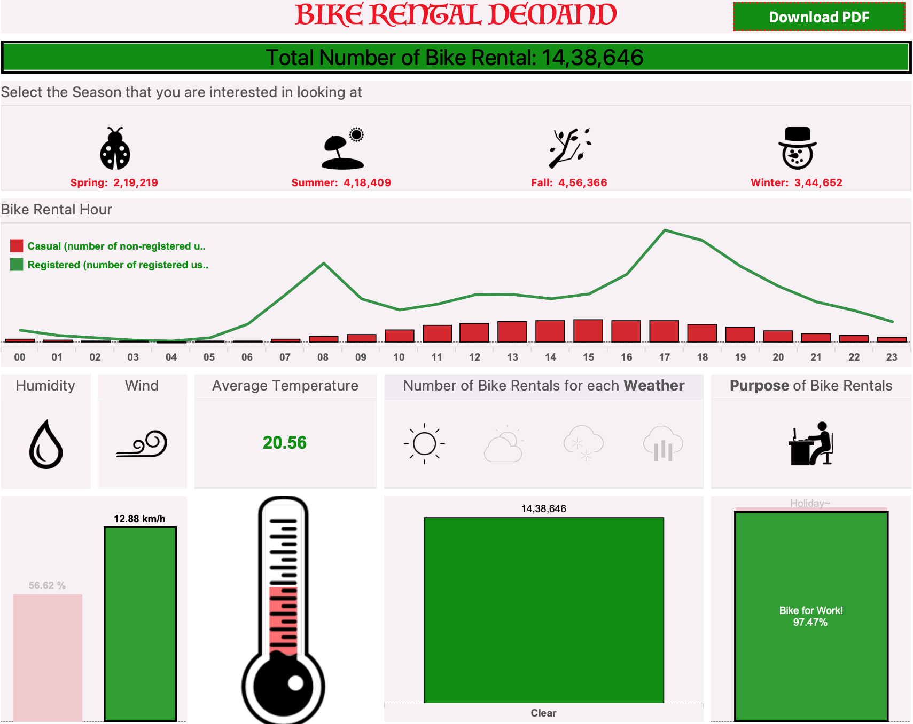
USER INTERFACE

Slide 13

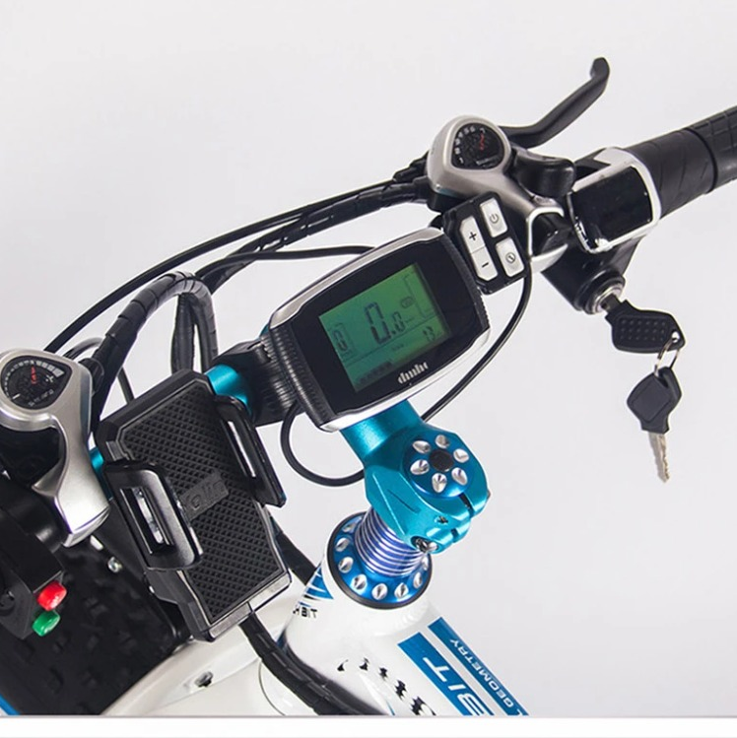
USER EVALUATION
Customers may be required to complete a registration form in order to become members of the Bike Rental for sustainability before using a bike rental service for the first time.
By way of registrations, customer information for statistical reasons and the written agreement to the terms of use are also recorded.
The Bike Rental determines the information that must be provided on registration forms. Such as Contact data(name, email, number etc), Other personal data for statistical purposes (gender, birthday), a username and a password to unlock the bicycle, the agreement of usage and payment terms necessary to uphold the terms of the contract between the operator and the client.

Slide 14
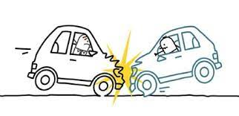
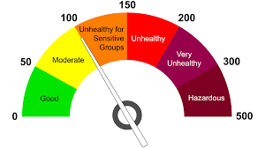


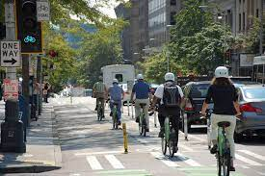
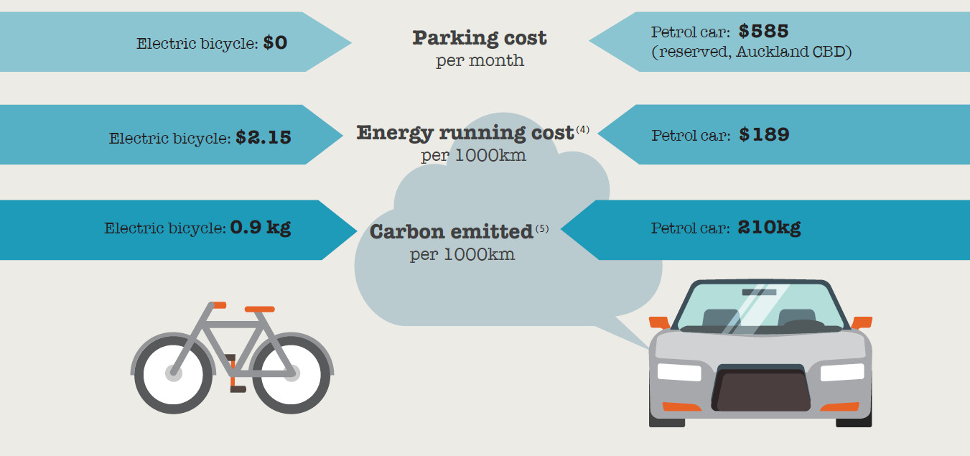

RESULT
REDUCE AIR POLLUTION
REDUCE ACCIDENT
IMPROVE AIR QUALITY
INCREASE FITNESS LEVEL
REDUCE TRAFFIC
REDUCE TRANSPORT COST
IMPROVE CITY IMAGE

Slide 15

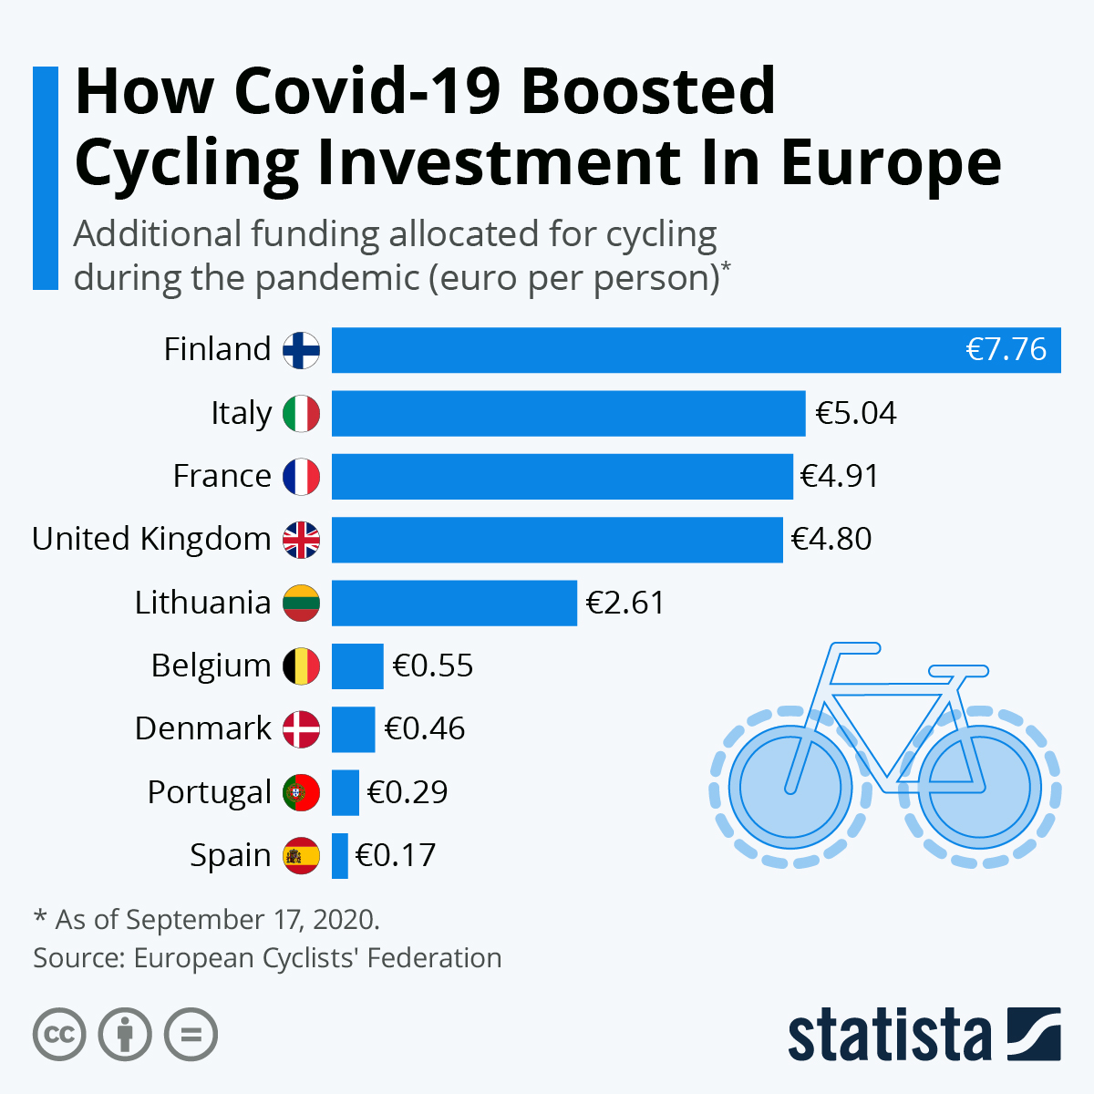
RESULTS
Covid-19 pandemic have forced other countries to follow suit as people avoid overcrowded public transportation systems and embrace their bicycles.
Bike renting has resulted in big business for bike manufacturers,34 of the EU's 94 biggest cities announcing that more than €1 billion has been spent on cycling infrastructure across Europe

Slide 16
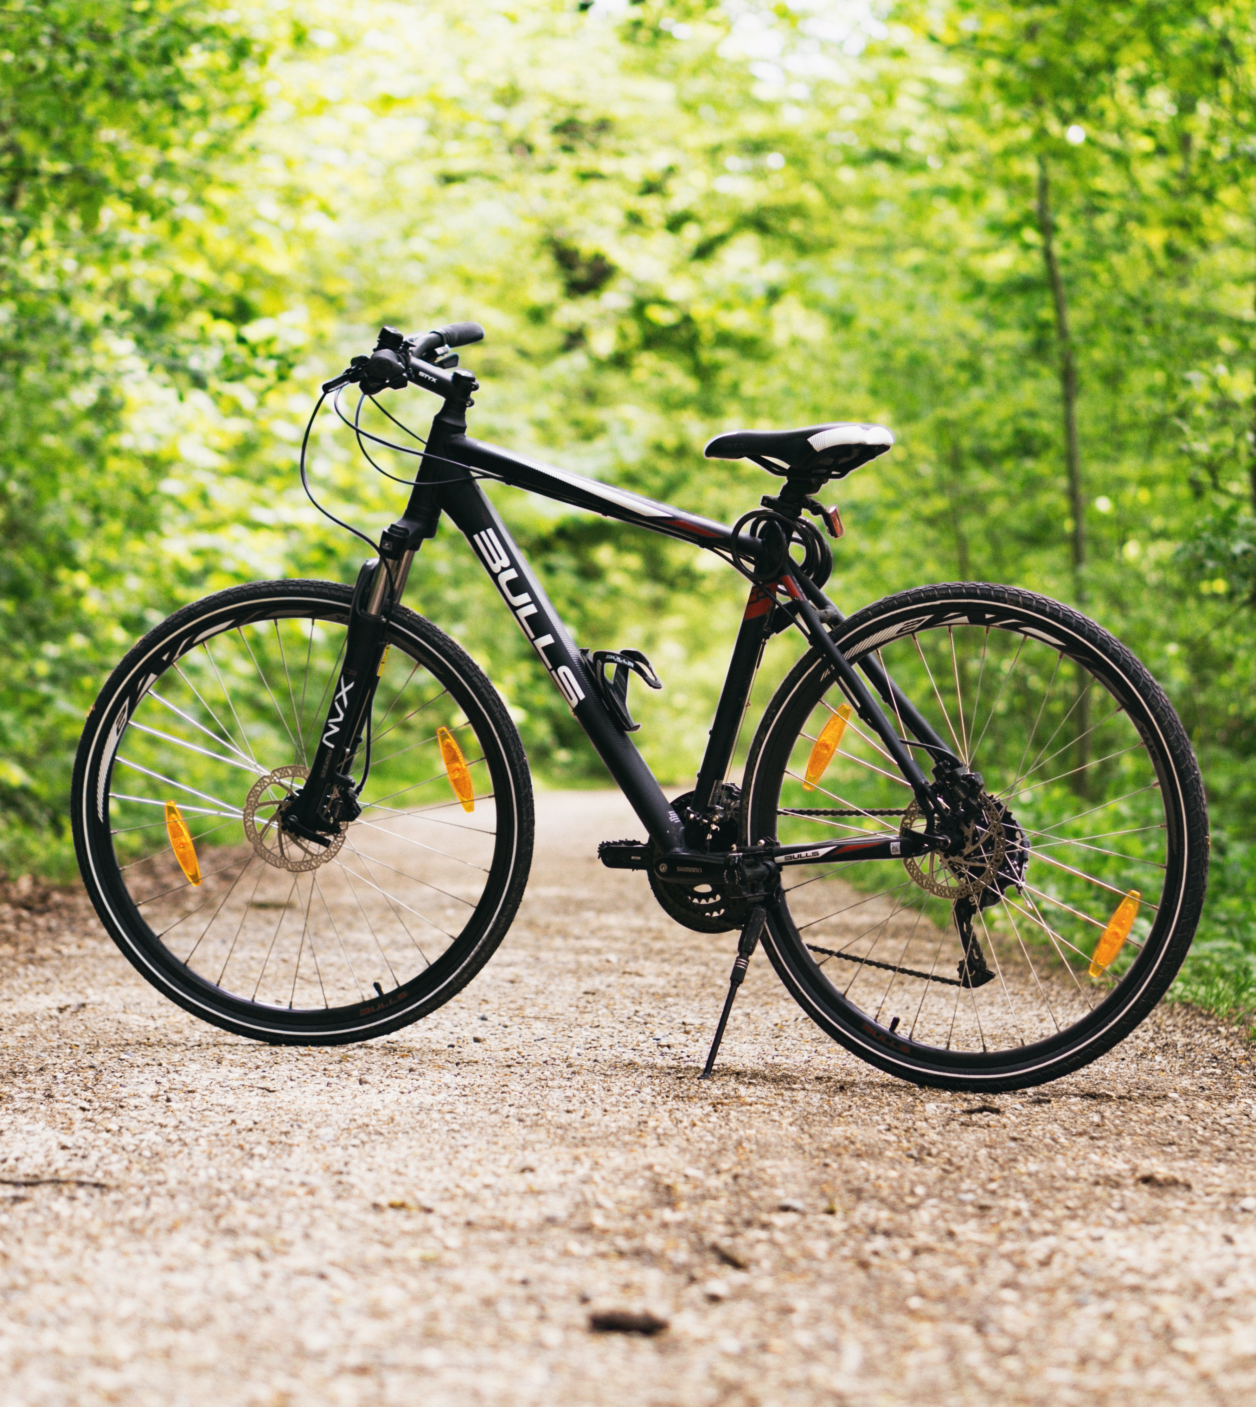
CONCLUSION
It will boost sustainable trips
Bike rental systems provide greater transportation options
Bike renting helps create a healthier workforce and a more interactive, competitive economy.
Bike rental schemes makes use of fewer cars, which leads to a reduction in greenhouse gases and an improvement in local air quality, which helps to support SDG 13(Climate action) Goal.
More efficient cities create more effective economies.

Slide 17


THANK YOU!
ANY QUESTION ?

